Slide 1
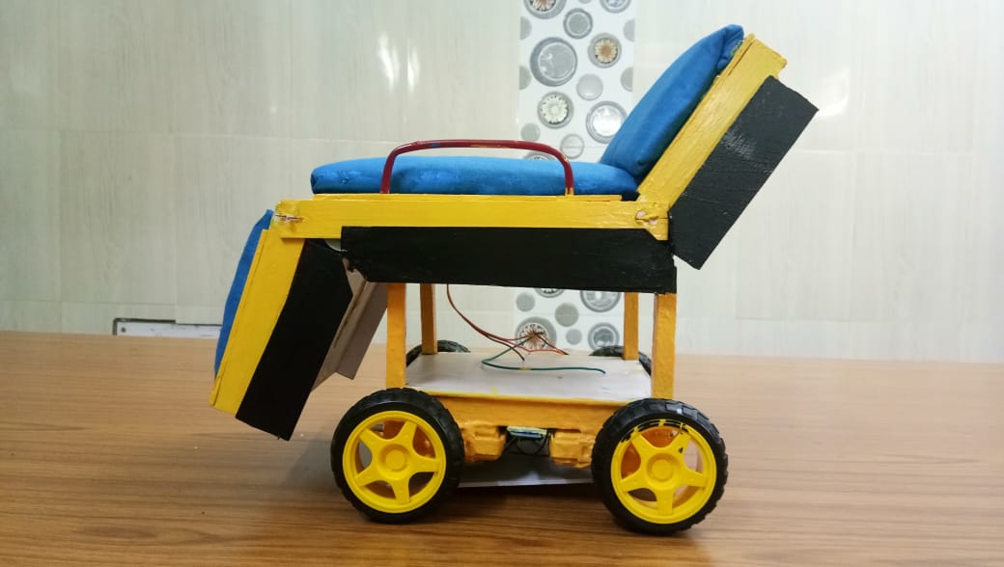
Seminar on Automatic Stretcher For Medical System
By
Anamika Mukherjee
(Dept. of Computer Science & Technology)
Roll No.05
Guide: Raj Kumar Datta
(Head of the Department of Computer Science & Technology)
Co-Guide: Debdeep Mukherjee
(Head of the Department of Electrical Engineering)

Slide 2
Contents
Introduction ……………………………………...………………………………………. ...3
Video of Demonstration ………………………….………….……………………………..4
Features …………………………………………….………………………………………...6
Working Principle ……………………………….………………………………………. ..7
The Stretcher Section ……………………………………….…………………………......8
Block Diagram of Stretcher Section ………………..…………………….……………...10
Sensing Device ………………………………………………………………………….. 12
Block Diagram of Sensing Device…………………... ……………………...…………….15
Control Room …………………………………...………………………………………….16
Block Diagram of Control Room …………………….…………….……………………17
Cost & Scalability ………………………………... ………………………………………..18
Maintenance …………………………….…………………………………………………..19
Conclusion ……………………………..…………………………………………………...20
References …………………………………………………………………………………..21
Some Moments …………………………...………………………………………………...22

Slide 3
Introduction
The workers /caretaker / attendant of the patients face the following problems in today’s hospital while using stretchers :
They cannot look after the other patients.
Patients having no caretaker have to wait for admission.
Sound noise is generated and also the path gets crowded.
Hiring more workers is basically very costly.

Slide 4
Our Solution To The Problems

Slide 5
Automatic Stretcher for Medical System

Slide 6
Features
The stretcher is designed for the medical patients, physically challenged people, and also for the aged persons having no caretaker.
A sensing device is designed to detects the desires of movements of the users automatically and move accordingly.
Patients can use voice commands for controlling the stretcher.
It can be controlled using a smartphone also.
It can be converted into a wheelchair as per the requirements.
The stretcher is smart enough in obstacle detection and avoidance.
Pressing an emergency button can make an emergency call to the control room.
The smart design of the bed made it easy to shift it into an ambulance.

Slide 7
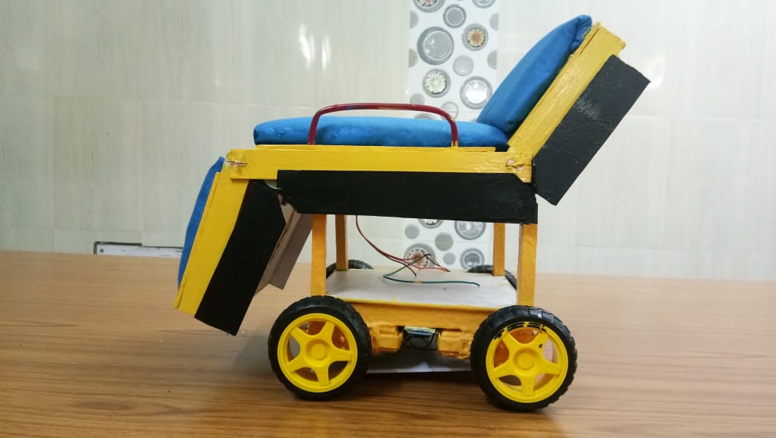
Working Principle
The working for the whole project is divided into three main sections which are:
(i) The Stretcher
(ii) The Sensing Device
(iii) The Control Room.

Slide 8
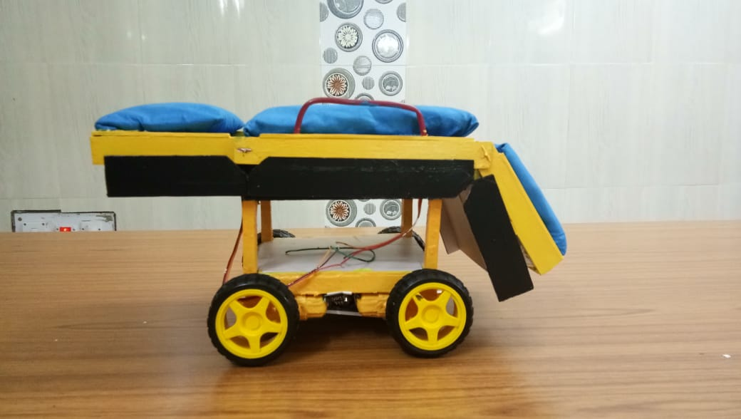
The Stretcher Section:
To control all the movements of the stretcher we use some d.c. and servo motors.
For recognizing voice commands we use both software and hardware mode.
Ultrasonic sensor is used for obstacle detecting.
We have used an arduino uno breakout board as a central unit.
For wireless communication between the sensing device and the control room we have used NRF24L01+ modules.
To connect a smartphone with the stretcher we have used a HC-05 module.
For sounding a horn we have used a buzzer.
For operating the circuits we have used 4V rechargeable batteries

Slide 10
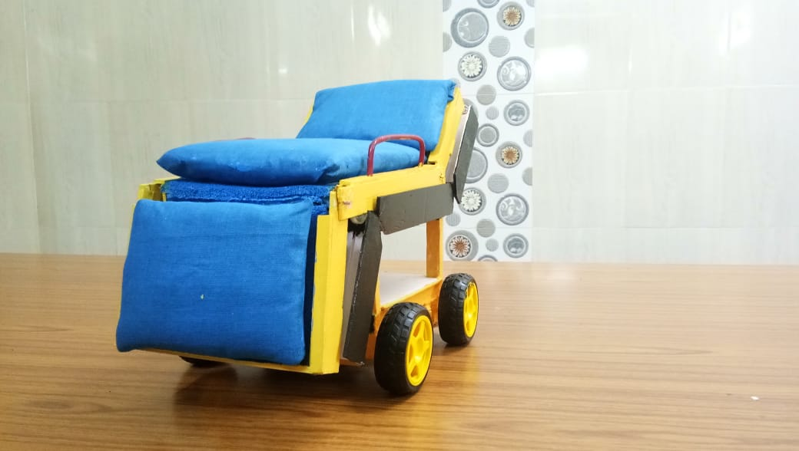
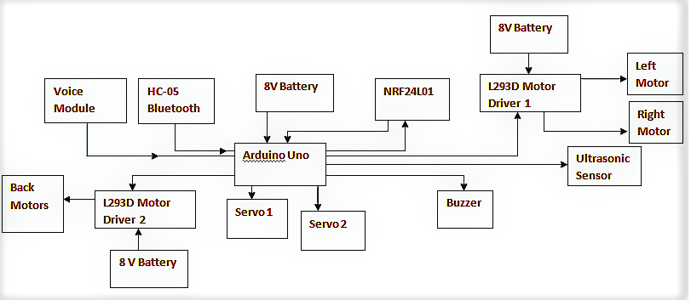
Block Diagram of Stretcher Section

Slide 11
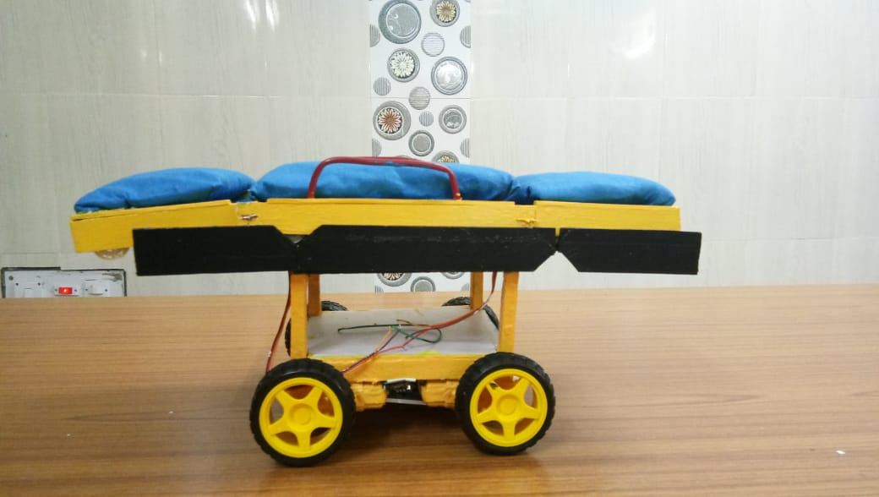
The Stretcher

Slide 12
Sensing Device
For detecting the desires of movements we have used an ADXL335 sensor.
An NRF24l01+ module send the output of the sensor wirelessly to the stretcher.
Arduino Nano breakout board is the control unit here.
The Sensing device is operated by a 9V battery.

Slide 13
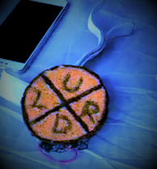
The Sensing Device

Slide 14
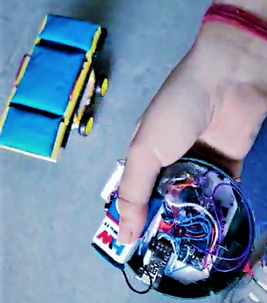

Slide 15
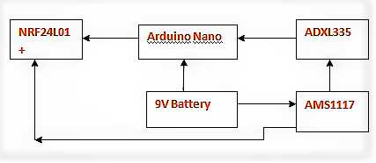
Block Diagram of the Sensing Device

Slide 16
Control Room
Red LEDs and green LEDs are used for status indication of stretchers.
An arduino Lilypad is the control unit here.
For wireless communication between control room and the stretchers we have used NRF24L01+ modules.

Slide 17
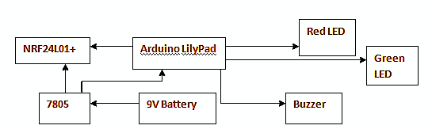
Block Diagram of Control Room

Slide 18
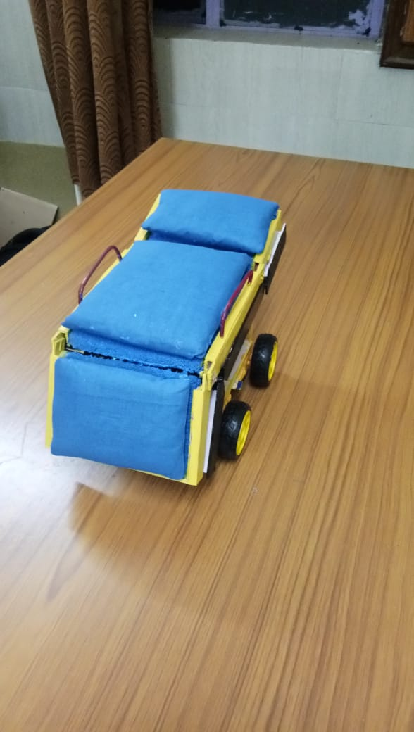
Cost & Scalability
We have designed the stretcher in such a way that it will be useful for medical system, physically challenged people and aged people in home who have no caretaker for taking care of them.
The sensing device will be very useful for the physically challenged people who can’t talk but can move their body parts.
This type of patients will also be able to use a smartphone to control the whole operation of the stretcher.
The people who can’t move their body but they can speak, can easily control the stretcher using voice commands.
Since the stretcher can be easily converted into a wheelchair , so it will be very useful for the people who have multiple disabilities.
The fabrication cost of this automatic robotics stretcher will be very low.

Slide 19
Maintenance
For operating no extra person will be needed as it is an automatic robotics stretcher which is smart enough to operate itself.
An extra person will be needed for monitoring all the stretchers in the control room.
This stretcher will be very easy to use for the common people, nurses or workers of a medical system.
When there will be any problem related to the stretcher’s operation a technician who is very much familiar with the microcontroller and embedded system, can easily troubleshoot that problem.

Slide 20
Conclusion
In upcoming future the hospitals can hire less workers and give the nation efficient service with less amount of headache.

Slide 21
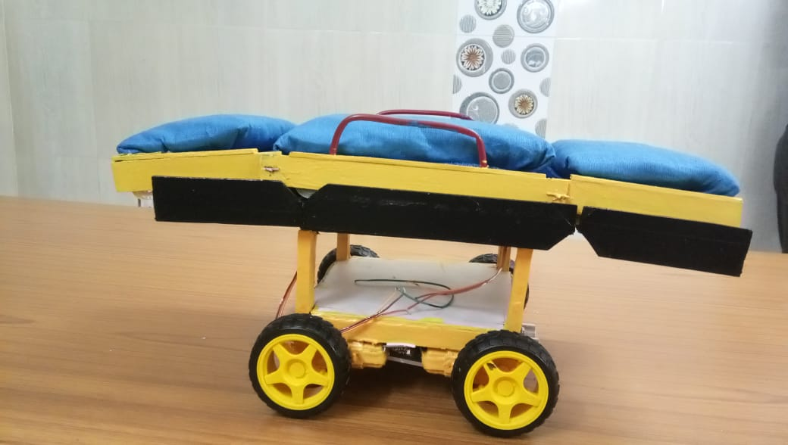
References
www.wikipedia.org
www.wikihow.tech
www.forum.arduino.cc
www.quora.com
www.brilliant.org
www.tutorialspoint.com
www.fritzing.com
www.electronicstoday.com
Datasheets of various sensors and electronics components

Slide 22
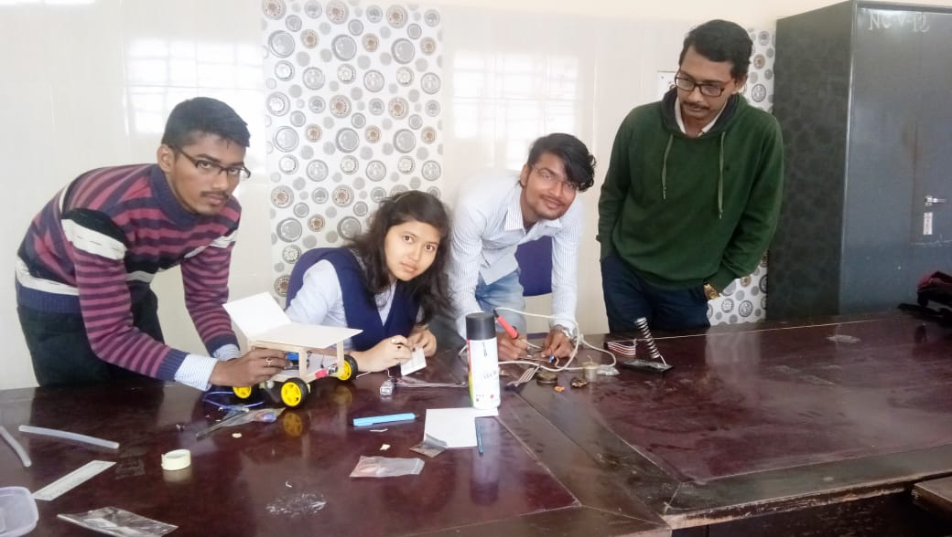
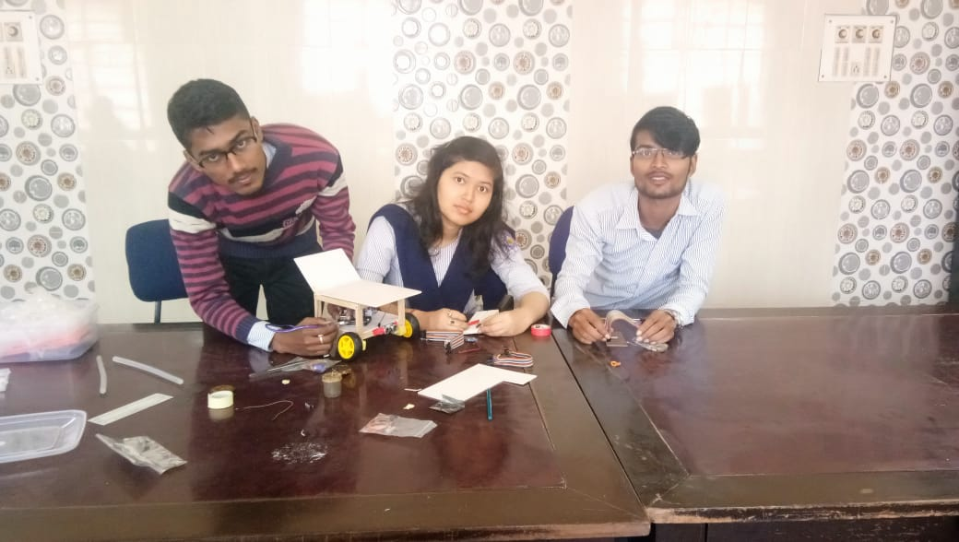
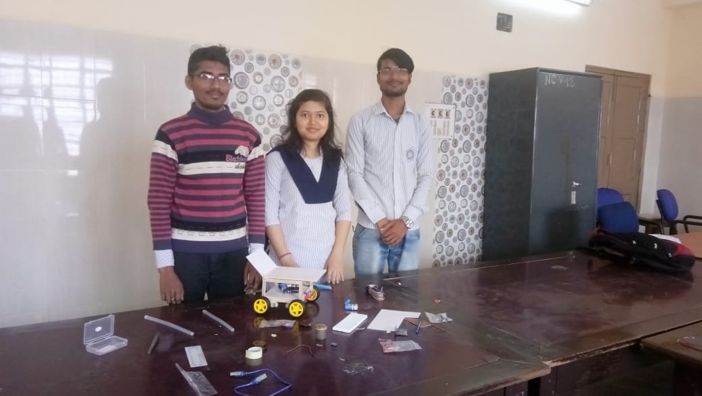
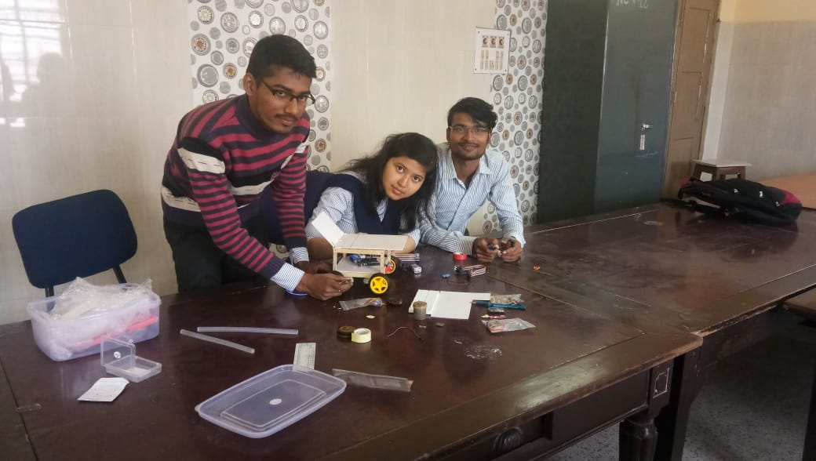
Some Moments During the Project Works

Slide 23
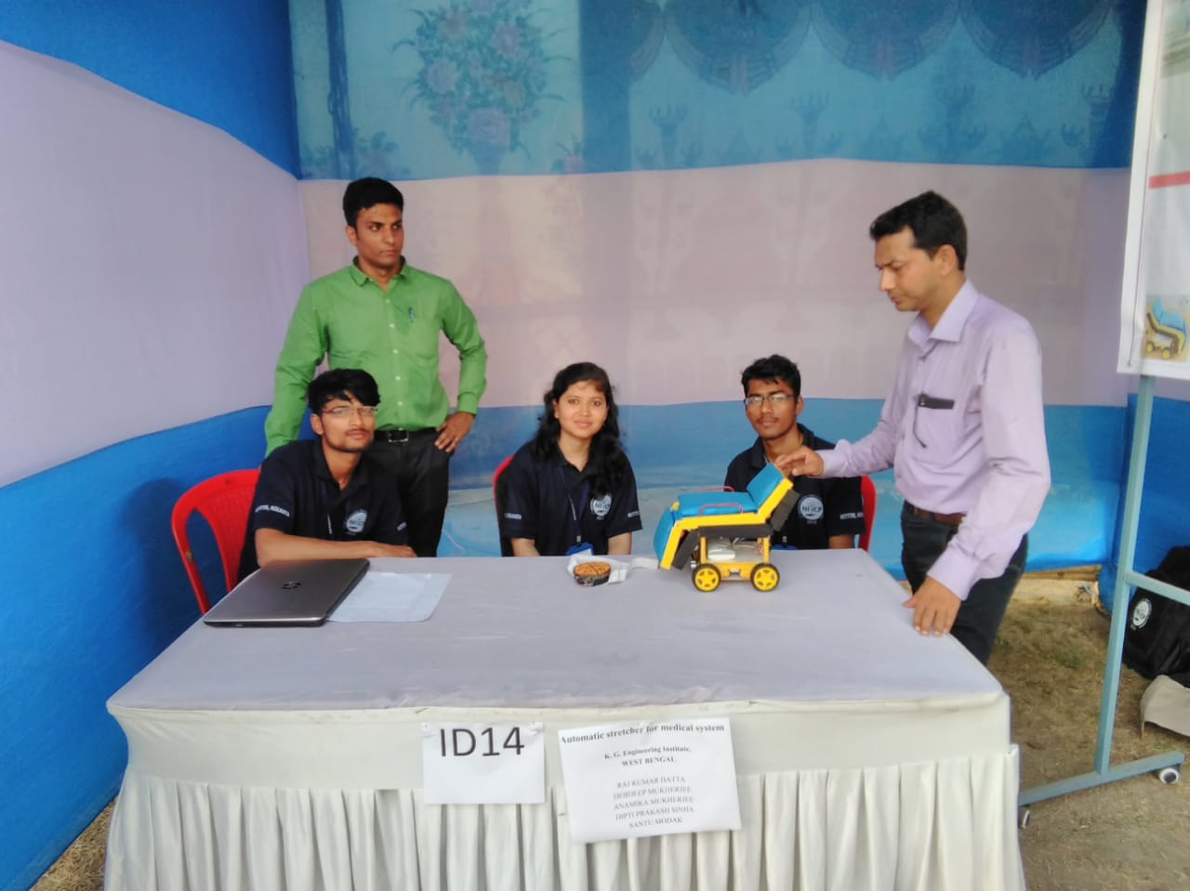
Some Moments at NITCP 2019

Slide 24
